Slide 1
DAAR ZIT MUZIEK IN!
09/11/22 - LES 6:
“Why wait any longer for the world to begin?”
thema: sex

Slide 2
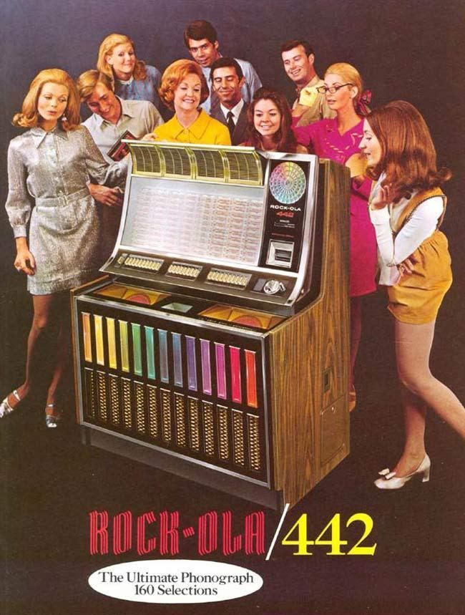
K&C JUKEBOX
https://open.spotify.com/playlist/5tbAfpVegjpnCDHNchjy7M?si=d92380ac9a7b432e
lievelingsliedje Amina

Slide 3
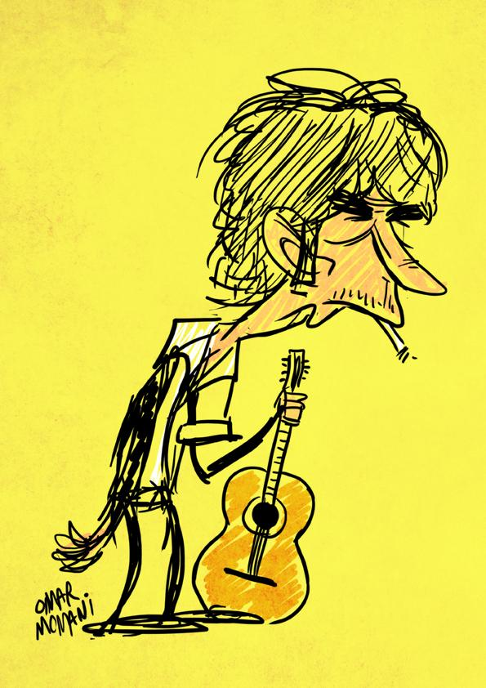
BOB VAN DE WEEK:
Lay, Lady, Lay!

Slide 4
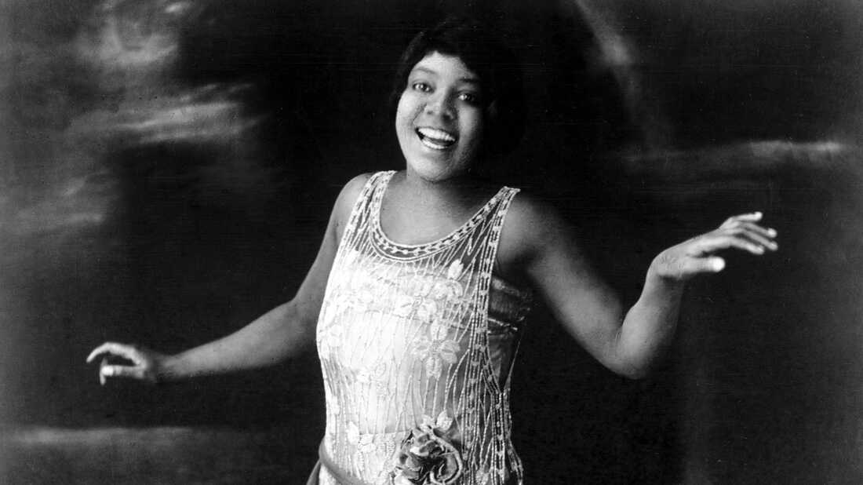
Need a Little Sugar in my Bowl (Bessie Smith/Clarence Williams)

Slide 5
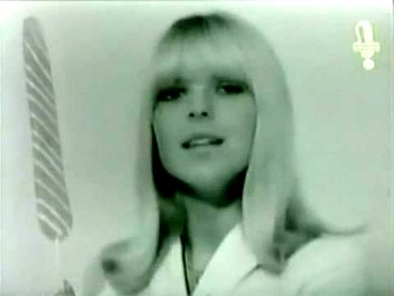
Les Sucettes (France Gall / Serge Gainsbourg)

Slide 6
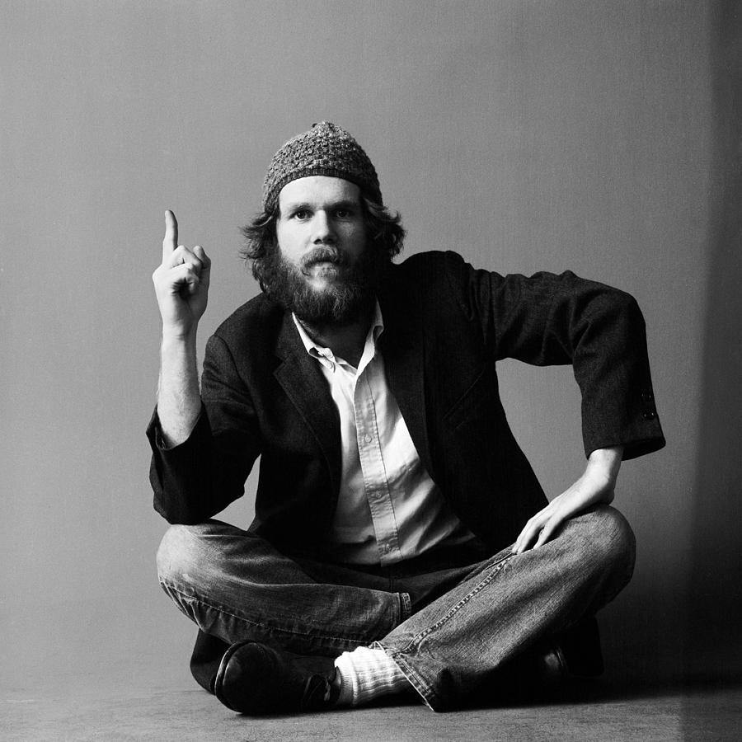
Motel Blues (Loudon Wainwright III)

Slide 7
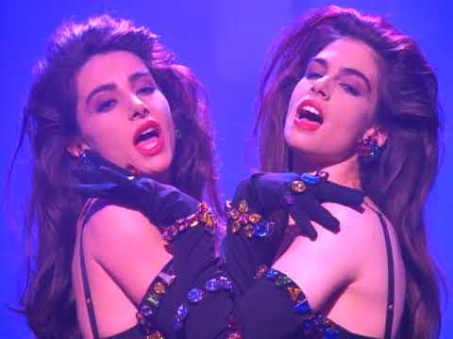
Cream (Prince)

Slide 8
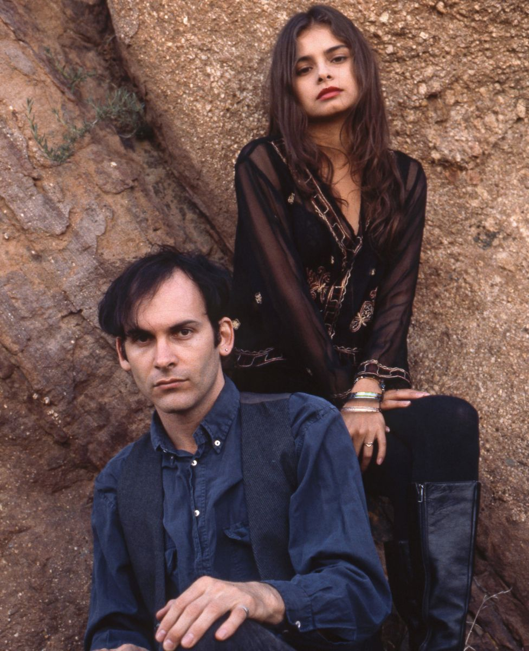
Five String Serenade (Mazzy Star/Arthur Lee)

Slide 9
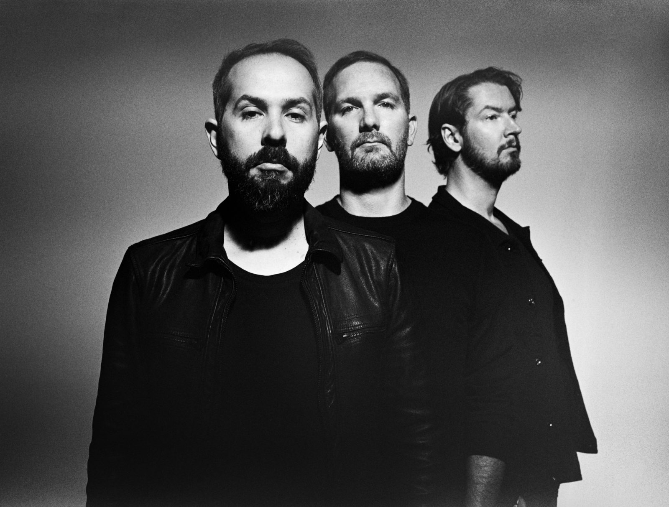
Nothing’s Gonna Hurt You Now (Cigarettes After Sex)

Slide 10
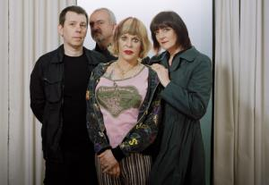
Something came over me / Throbbing Gristle

Slide 11
DOE DE BOB 6: Aan de slag!
Jullie schreven nu al 5 liedjes.
Tijd om alles nog eens door te nemen.
Wat vonden jullie het beste resultaat. Waarmee willen jullie verder?
Na vandaag zijn er nog 3 lessen.
Tegen dan zouden jullie minstens één liedje moeten afwerken.

Slide 12
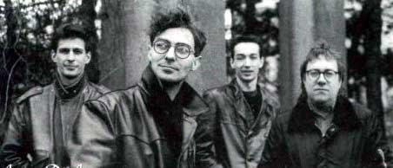
‘t Is de liefde (Amore di Amore)

Slide 13
BOBS LEVENSLES:
“Sex and love have nothing to do with female and male. It is just whatever two souls happen to be. It could be male and female, and it might not be male and female. It might be female and female or male and male. You can’t turn your back on it, man. You can try to pretend it doesn’t happen, and you can try to make fun of it and be snide, but that’s not really the rightful thing. I know, I know.”

